Slide 1
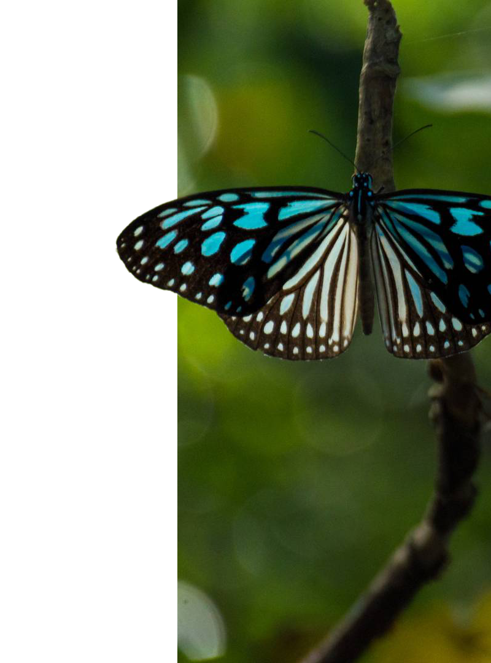
The History of sexual selection
Course by Danial Borzoo

Slide 2
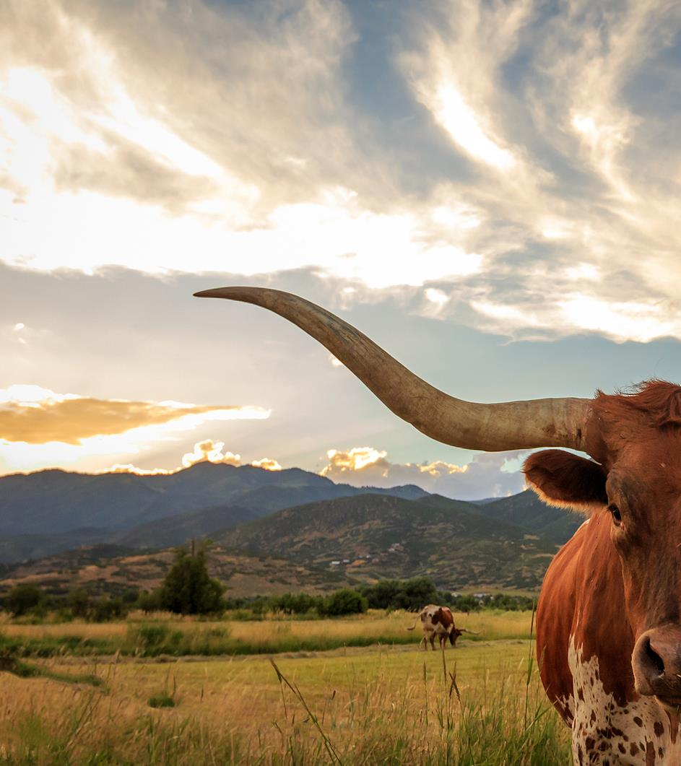
01
lesson
The Emergence of Evolution,
and Sexual Selection

Slide 3
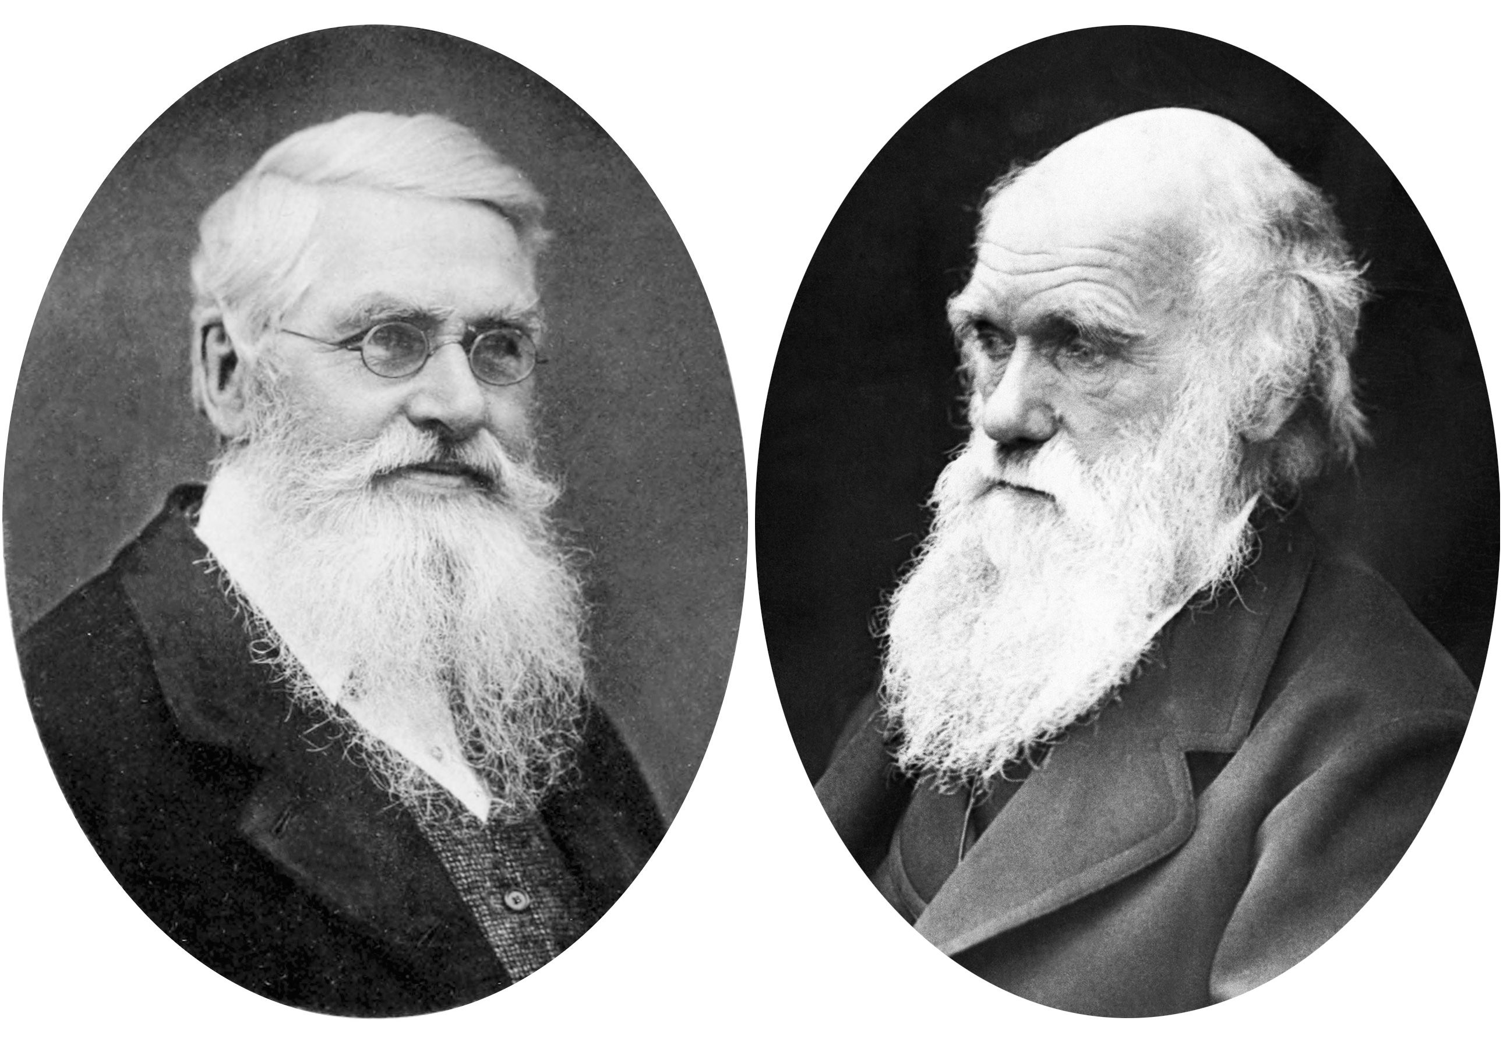
Darwin Vs. Wallace
From Co-discovery to Rivalry

Slide 4
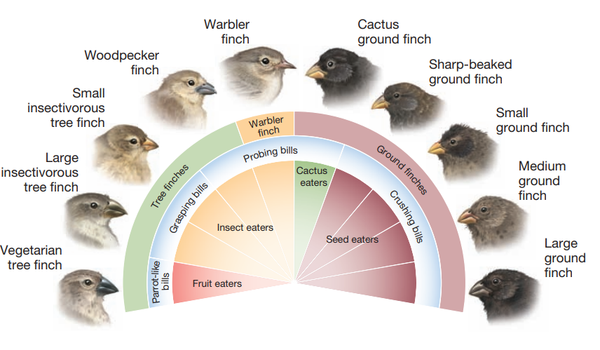
Darwin’s finches

Slide 5
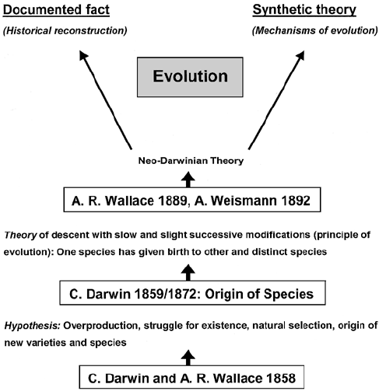
Darwin Vs. Wallace
Differences

Slide 6
Darwin’s Sexual Selection
“There are many other structures and instincts which must have been developed through sexual selection, most of these latter structures serving only to allure or excite the female. It is clear that these characters are the result of sexual and not of ordinary selection, since unarmed, unornamented, or unattractive males would succeed equally well in the battle for life and in leaving a numerous progeny, but for the presence of better-endowed males.”

Slide 7
Darwin’s Sexual Selection
“When we behold two males fighting for the possession of the female, or several male birds displaying their gorgeous plumage, and performing strange antics before an assembled body of females, we cannot doubt that, though led by instinct, they know what they are about, and consciously exert their mental and bodily powers.”

Slide 8
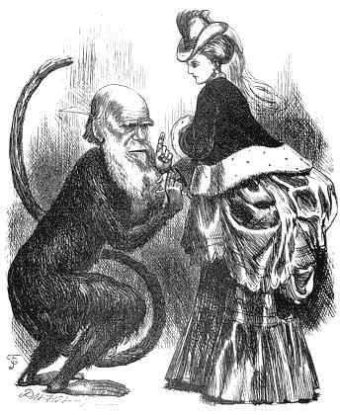
Darwin’s Sexual Selection

Slide 9
What was the problem?
“Female birds in a state of nature have, by a long selection of the more attractive males, added to their beauty or other attractive qualities. No doubt this implies powers of discrimination and taste on the part of the female which will at first appear extremely improbable”

Slide 10
What was the problem?
“Our difficulty in regard to sexual selection lies in understanding how it is that the males which conquer other males, or those which prove the most attractive to the females, leave a greater number of offspring to inherit their superiority than their beaten and less attractive rivals.”
Notes:
Let us take any species, a bird for instance, and divide the females inhabiting a district into two equal bodies, the one consisting of the more vigorous and better-nourished individuals, and the other of the less vigorous and healthy. The former, there can be little doubt, would be ready to breed in the spring before the others. There can also be no doubt that the most vigorous, best-nourished and earliest breeders would on an average succeed in rearing the largest number of fine offspring. The males, as we have seen, are generally ready to breed before the females; the strongest, and with some species the best-armed of the males, drive away the weaker; and the former would then unite with the more vigorous and better-nourished females, because they are the first to breed.

Slide 11
What was the problem?
“We are led to the rather complex conclusion, that the more eager males will leave more descendants, and those that are better endowed with ornaments will be the ones selected. But unless it can be shown that there is some connection between greater eagerness and better ornamentation, it might often occur that the less ornamented were the more eager individuals, in which case there would be an apparent conflict between the two acquirements.”

Slide 12
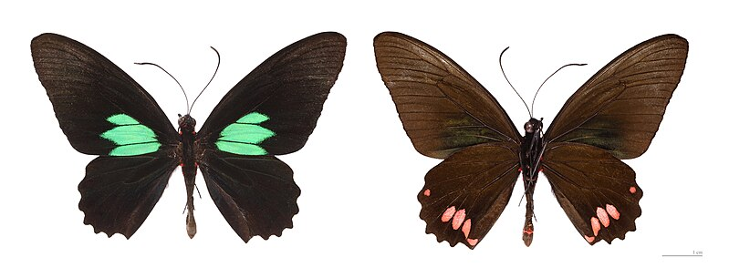
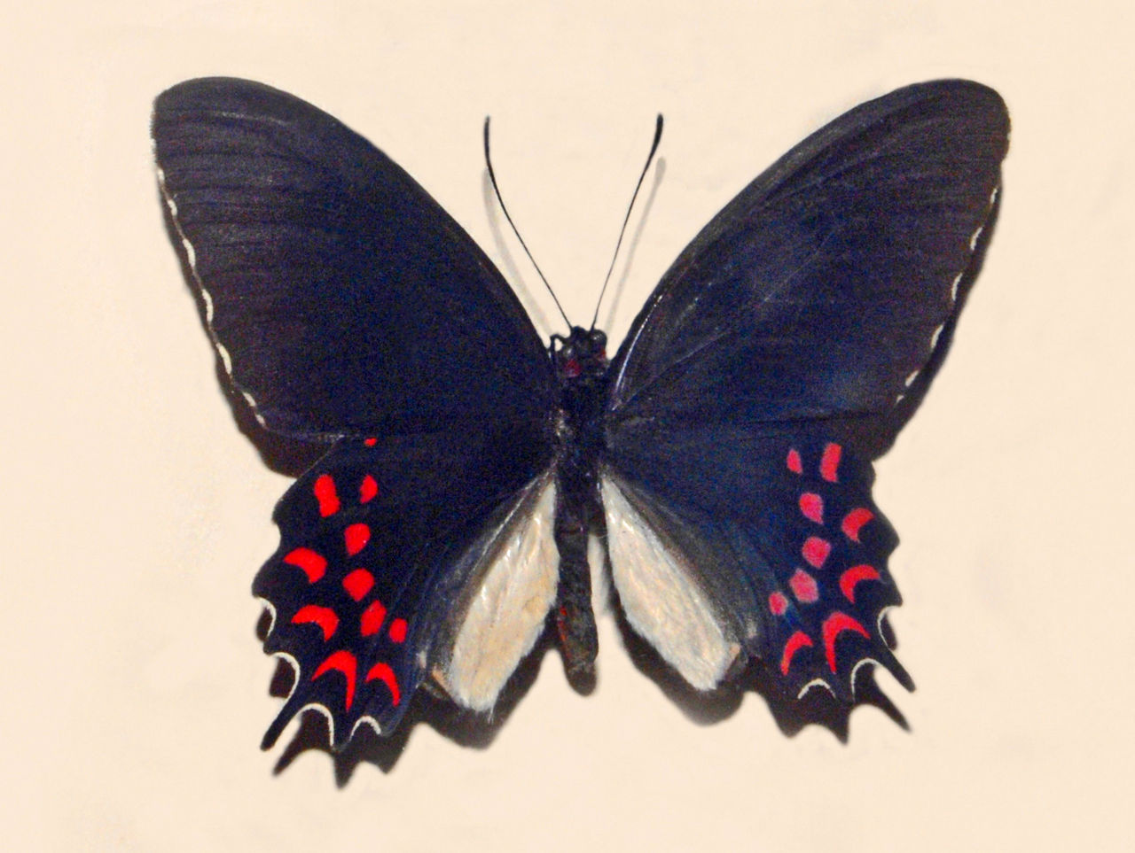
Wallace’s Sexual Selection
“The greater purity and intensity of color seem to be usually associated with more pointed wings, indicating greater vigor and more rapid flight.”

Slide 13
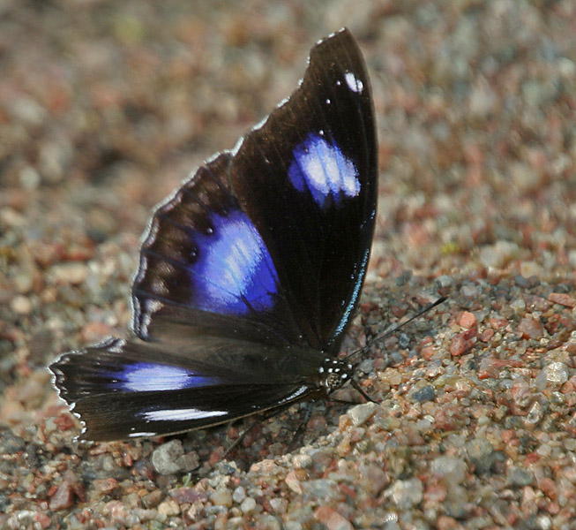
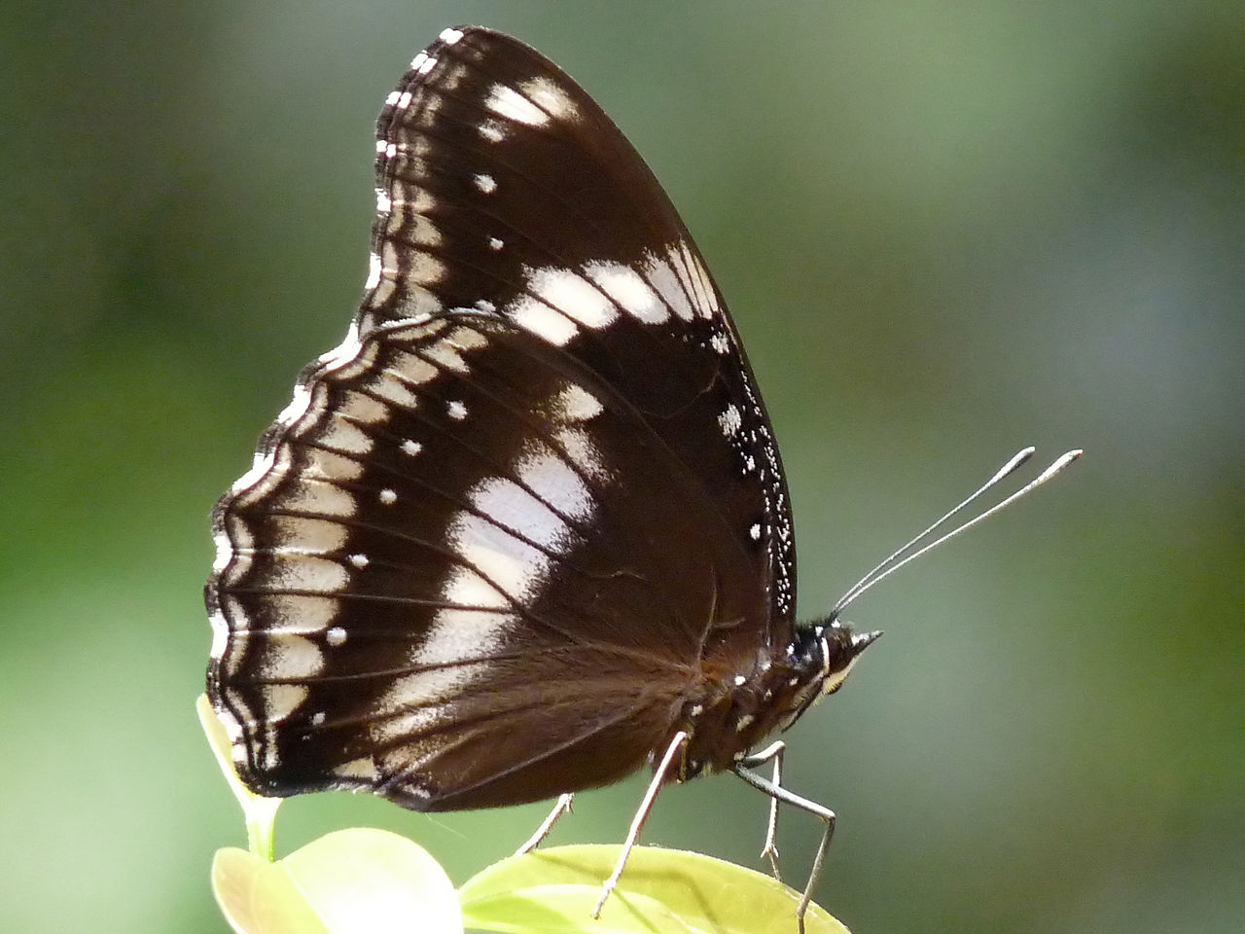
Wallace’s Sexual Selection

Slide 14
What was the problem?
“But it is difficult to understand why the males of species, of which the progenitors were primordially free, should invariably have acquired the habit of approaching the females, instead of being approached by them.”

Slide 15
What was the problem?
“There is just as much need to explain why the females are gifted with an appreciation of the beautiful, as that the beautiful colors develop in the males.
Darwin assumes that the appreciation on the part of the female is always present, and he thus simplifies, in appearance, the problem, but he leaves half of it unexplained.”

Slide 16
02
lesson
The evolution of anisogamy

Slide 17
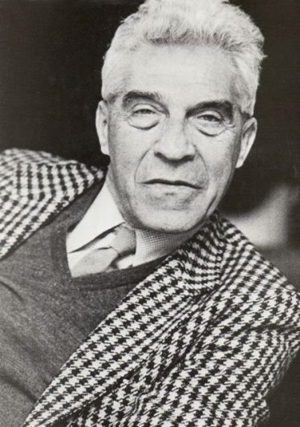
H. Kalmus 1932’s model

Slide 18

H. Kalmus 1932’s model
$$m_{1}+m_{2}=2m$$
$$x_{1}=\frac{MP}{m_{1}}$$
$$x_{2}=\frac{M(1−P)}{m_{2}}$$

Slide 19

H. Kalmus 1932’s model
$$N_{1}=\frac{cx\left(x−1\right)}{2}$$
$$N_{2}=cx_{1}x_{2}$$
$$N_{2}=cx_{1}x_{2}=\frac{cM^{2}p(1−p)}{m_{1}(2m−m_{1})}$$

Slide 20

H. Kalmus 1932’s model
$$\frac{M^{2}}{4m_{1}m_{2}}>\frac{M^{2}}{2m^{2}}$$
$$θ^{2}−6θ+1>0$$
$$\frac{m_{2}}{m}>2(1−p)$$

Slide 21
Charlesworth 1978’s Model of haploid organism

Slide 22

Charlesworth 1978’s Model of haploid organism
$$y_{i}=\frac{x_{i}n_{i}}{\sum_{j}{x_{j}n_{j}}}$$
$$x_{i}^{′}=\frac{y_{i}\sum_{j}{y_{j}v_{ij}}}{\sum_{jk}{y_{j}y_{k}v_{jk}}}$$
$$w_{jk}=n_{j}n_{k}v_{jk}$$

Slide 23
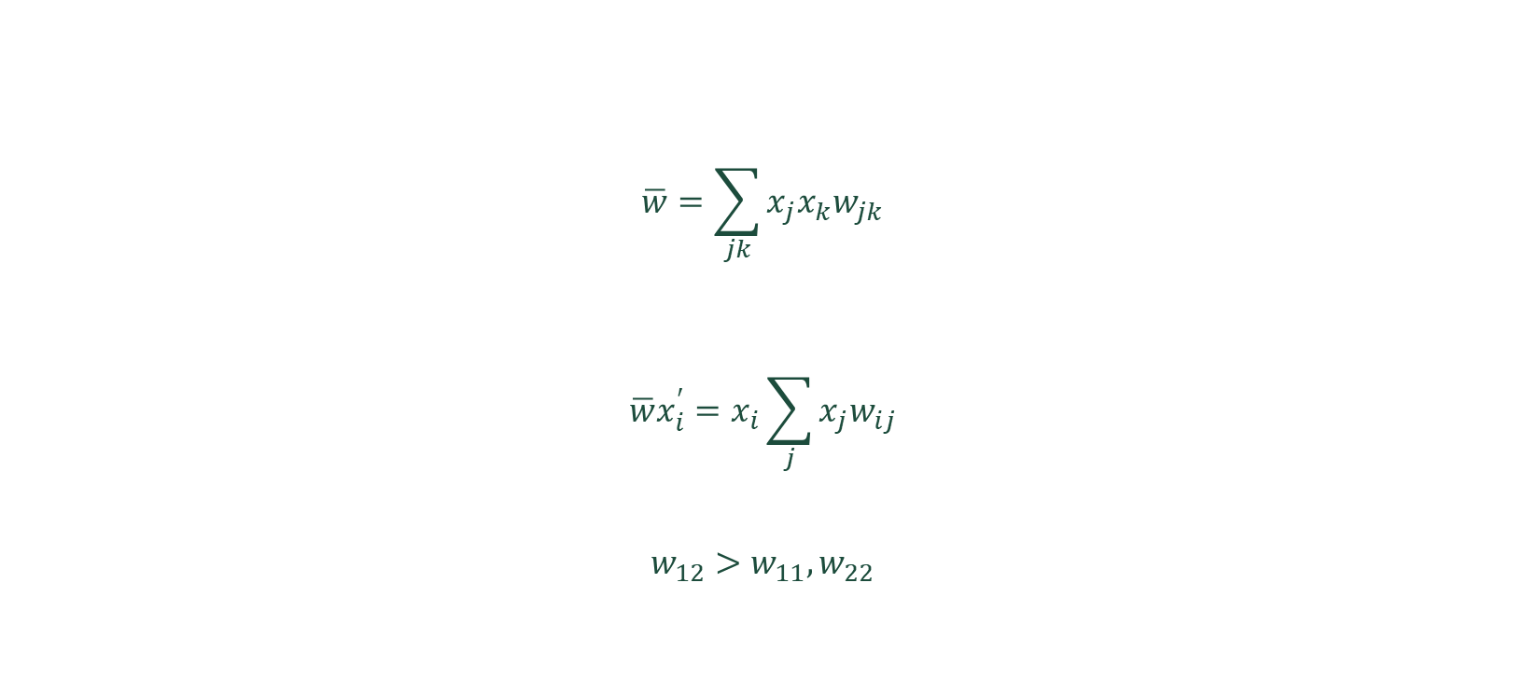
Charlesworth 1978’s Model of haploid organism
$$\overline{w}=\sum_{jk}{x_{j}x_{k}w_{jk}}$$
$$\overline{w}x_{i}^{′}=x_{i}\sum_{j}{x_{j}w_{ij}}$$
$$w_{12}>w_{11},w_{22}$$

Slide 24

Charlesworth 1978’s Model of haploid organism
$$\hat{p}w_{11}+\left(1−\hat{p}\right)w_{12}=\hat{p}w_{12}+\left(1−\hat{p}\right)w_{22}$$
$$\hat{p}=\frac{w_{22}−w_{12}}{\left(w_{11}−w_{12}\right)+(w_{22}−w_{12})}`$$
$$\frac{x_{1}}{x_{2}}=\frac{w_{12}−w_{22}}{w_{12}−w_{11}}$$

Slide 25

Charlesworth 1978’s Model of haploid organism
$$v_{ij}=αm_{ij}^{k}$$
$$\frac{w_{12}}{w_{11}}=2^{−k}θ^{1−k}{\left(1+θ\right)}^{k}>1$$
$$\frac{w_{12}}{w_{22}}=2^{−k}θ^{−1}{\left(1+θ\right)}^{k}>1$$

Slide 26
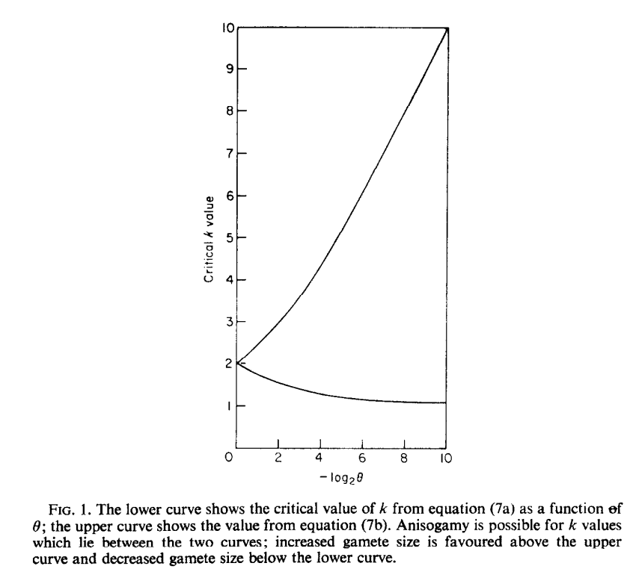
Charlesworth 1978’s Model of haploid organism

Slide 27
Charlesworth 1978’s Model of diploid organism

Slide 28
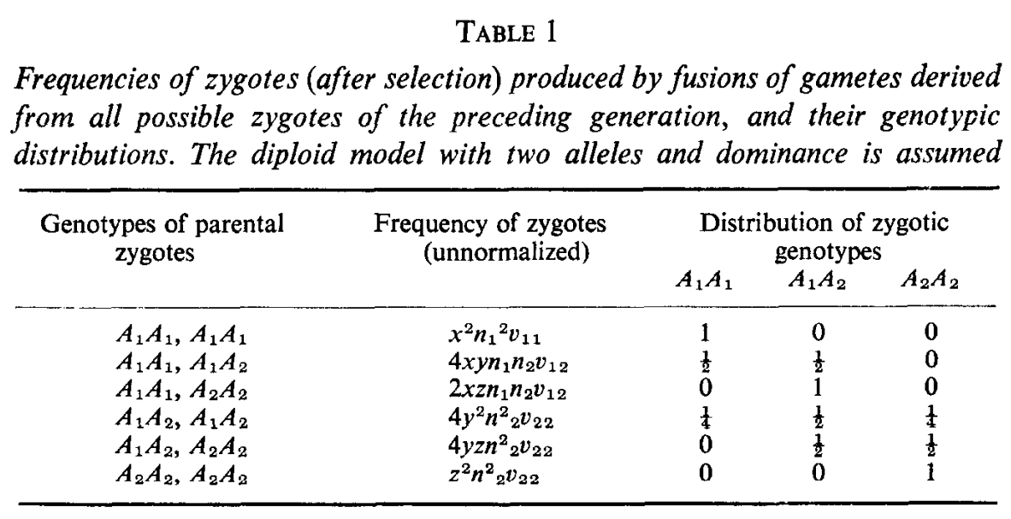
Charlesworth 1978’s Model of diploid organism

Slide 29

Charlesworth 1978’s Model of diploid organism
$$\overline{w}x^{′}=x^{2}w_{11}+y^{2}w_{22}+2xyw_{12}$$
$$\overline{w}y^{′}=\left(y+z\right)\left(xw_{12}+yw_{22}\right)$$
$$\overline{w}z^{′}={\left(y+z\right)}^{2}w_{22}$$
$$w_{11}y^{′}≈yw_{12}$$

Slide 30

Charlesworth 1978’s Model of diploid organism
$$x^{′}+y^{′}=x\frac{w_{12}}{w_{22}}+y$$
$$\overline{w}=\hat{x}w_{12}+\left(2\hat{y}+\hat{z}\right)w_{22}$$
$$\overline{w}=\hat{x}w_{11}+\left(2\hat{y}+\hat{z}\right)w_{12}$$
$$\frac{\hat{x}}{\left(2\hat{y}+\hat{z}\right)}= \frac{w_{12}−w_{22}}{w_{12}−w_{11}}$$

Slide 31
What was the problem?
“Our difficulty in regard to sexual selection lies in understanding how it is that the males which conquer other males, or those which prove the most attractive to the females, leave a greater number of offspring to inherit their superiority than their beaten and less attractive rivals.”
Notes:
Let us take any species, a bird for instance, and divide the females inhabiting a district into two equal bodies, the one consisting of the more vigorous and better-nourished individuals, and the other of the less vigorous and healthy. The former, there can be little doubt, would be ready to breed in the spring before the others. There can also be no doubt that the most vigorous, best-nourished and earliest breeders would on an average succeed in rearing the largest number of fine offspring. The males, as we have seen, are generally ready to breed before the females; the strongest, and with some species the best-armed of the males, drive away the weaker; and the former would then unite with the more vigorous and better-nourished females, because they are the first to breed.

Slide 32
03
lesson
The Fisherian Self-Reinforcing Sexual Selection

Slide 33
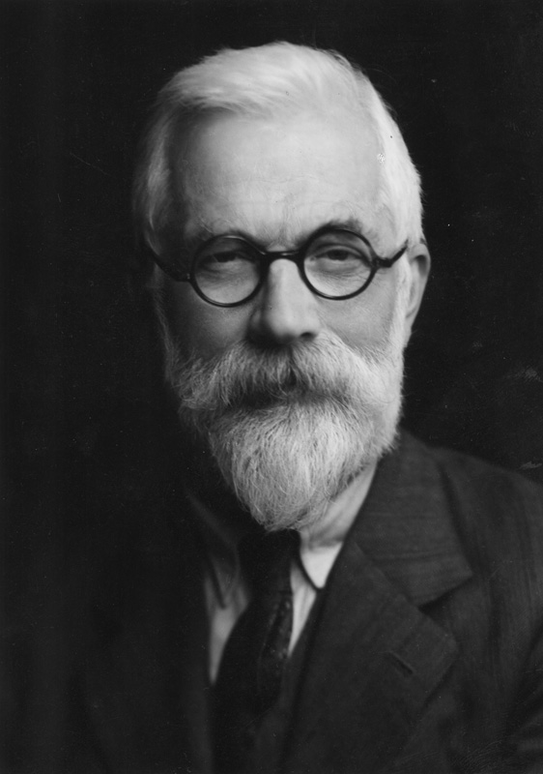
R. A. Fisher

Slide 34
Morgan’s 1903 Critics
“Shall we assume that still another process of selection is going on, . . . that those females whose taste has soared a little higher than that of the average (a variation of this sort having appeared) select males to correspond, and thus the two continue heaping up the ornaments on one side and the appreciation of these ornaments on the other? No doubt an interesting fiction could be built up along these lines, but would anyone believe it, and, if he did, could he prove it?”
Notes:
To begin addressing this question, we need to recognize that an animal's success in surviving and reproducing is not solely determined by how many offspring it produces. Equally important is the potential success of those offspring. When females choose mates from a pool of competitors, they are essentially making decisions that could impact the survival of their future young. Selecting a mate who is likely to produce healthy and viable offspring becomes a vital strategy for ensuring the continuation of their genetic line.

Slide 35
Fisher’s Runaway
“The individual here faces a problem of extraordinary complexity, closely akin to, though not identical with, that of the eugenist, namely, the problem of selecting that type, out of those which present themselves, which is most in accord with the prevailing conditions of life, and which has the best chance of overcoming the enormous variety of dangers and difficulties with which every species is surrounded.”

Slide 36
Fisher’s Runaway
“In every animal there are a few noticeable points or features which readily attract and arrest the attention; and of these it may be expected, in general, that some will be more conspicuous among the healthy, active and biologically fit, while others will be more noticeable in those less well endowed with health and vigour.”

Slide 37
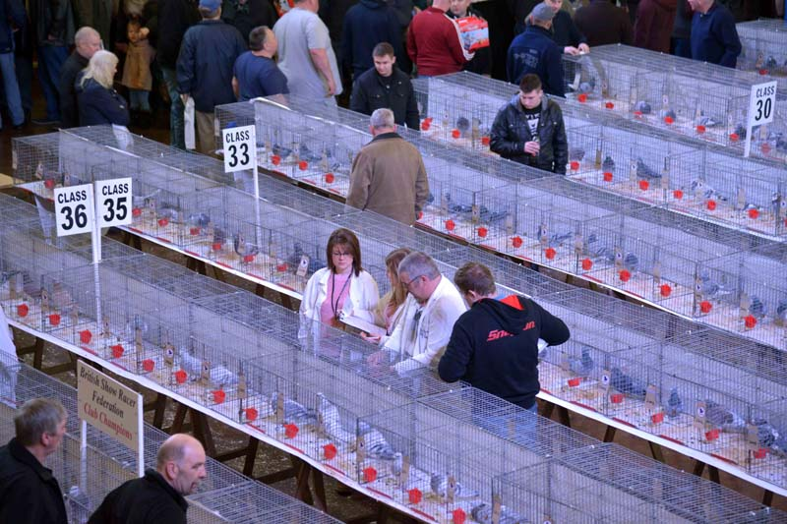
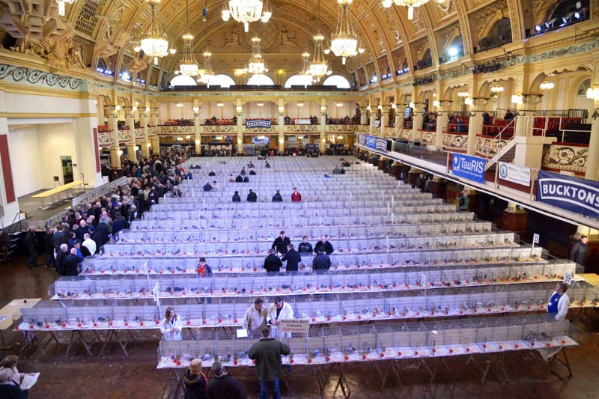
Fisher’s Runaway

Slide 38
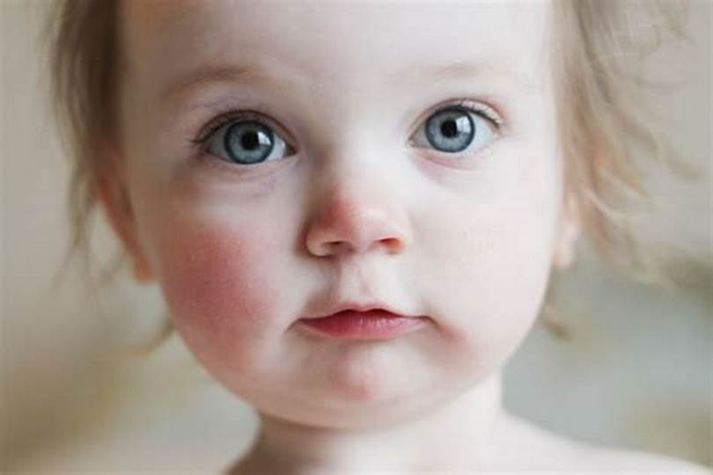
Fisher’s Runaway

Slide 39
Fisher’s Runaway
“We may well suppose, then, that the tastes of all
living creatures were not diverted from the first by any universal bias, but were modified in the course of evolution, like their organs and faculties, in accordance with the biological needs of different species.”

Slide 40
Fisher’s Runaway
“Even if, in the course of time, it ceases to be any
index of vitality whatever, the taste for it would continue to increase in strength, if it has already become strong, because although the offspring show no general superiority in the ordinary course of life, they retain their ascendancy in sexual selection, and have, therefore, a better chance of surviving; ”

Slide 41
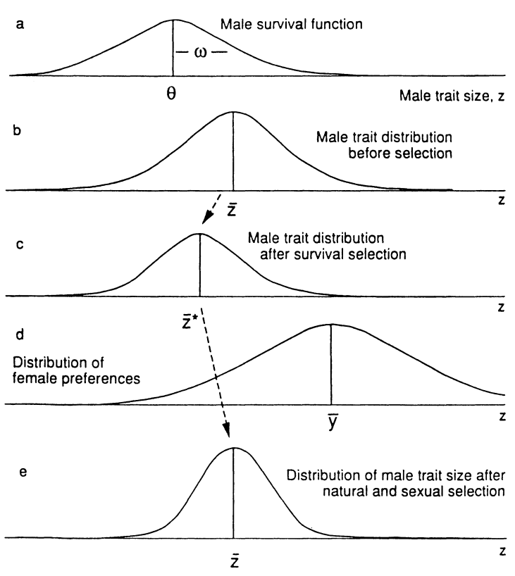

Slide 42
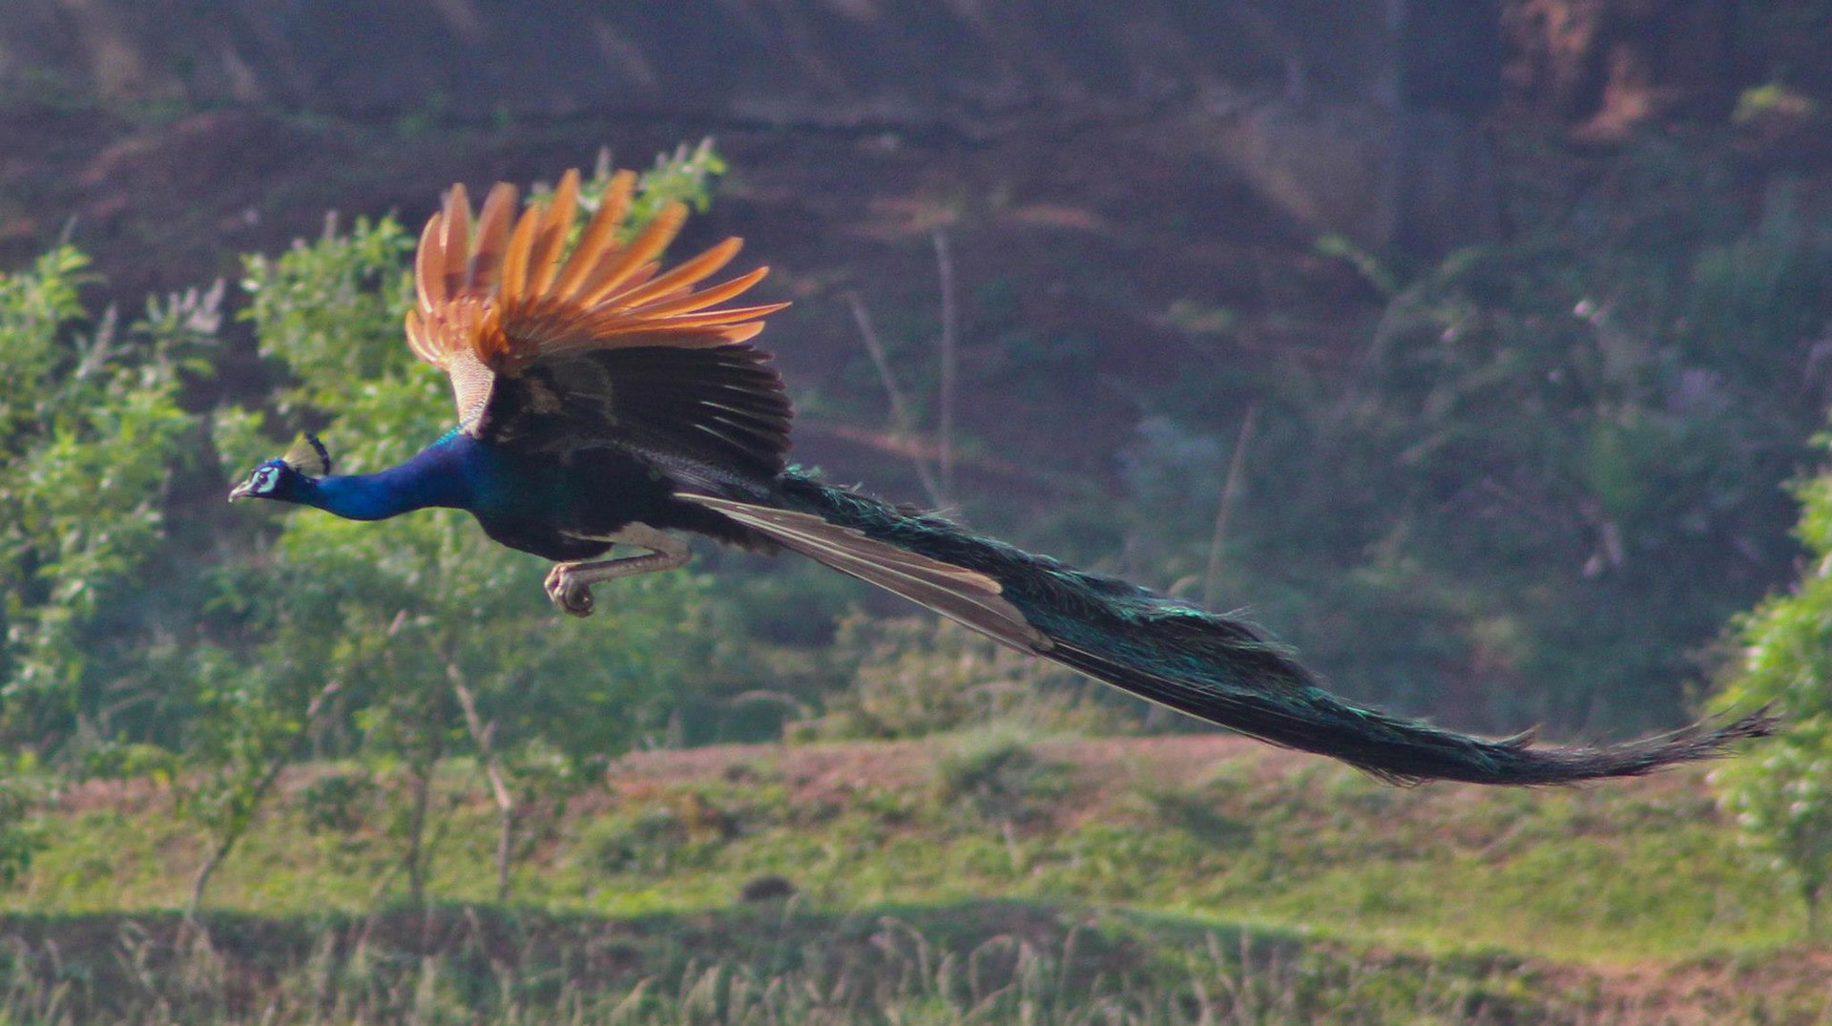

Slide 43
Fisher’s Runaway
“It is only when a feature has become so harmful as to overbalance this advantage that the taste for it among the females will have reached its maximum and will begin to diminish.”
Notes:
We may, therefore, observe three phases in the history of a secondary sexual trait. In the first it is favoured by natural selection, and being simple and easily apprehended as a "point," its advantage is slowly increased by the development of sexual selection in its favour; in the second phase it owes nothing to natural selection, which may even have turned against it, but it still increases in splendour and perfection, and the importance attached to it by the opposite sex still increases, so long as it retains a balance of advantage. Finally, perhaps, an equilibrium will be attained in which natural selection just balances sexual selection. But this equilibrium must be expected in general to be broken by the rise of other " points " of interest and importance, and will be followed by the gradual decay both of the feature itself, and in the appreciation of it by the opposite sex.

Slide 44
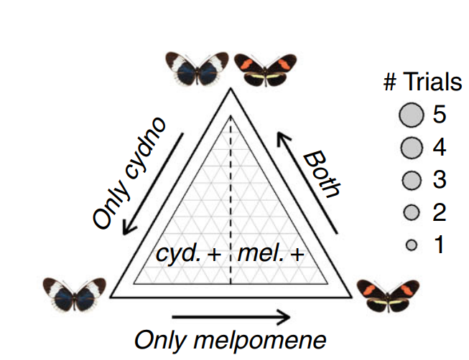
Fisher’s Runaway

Slide 45
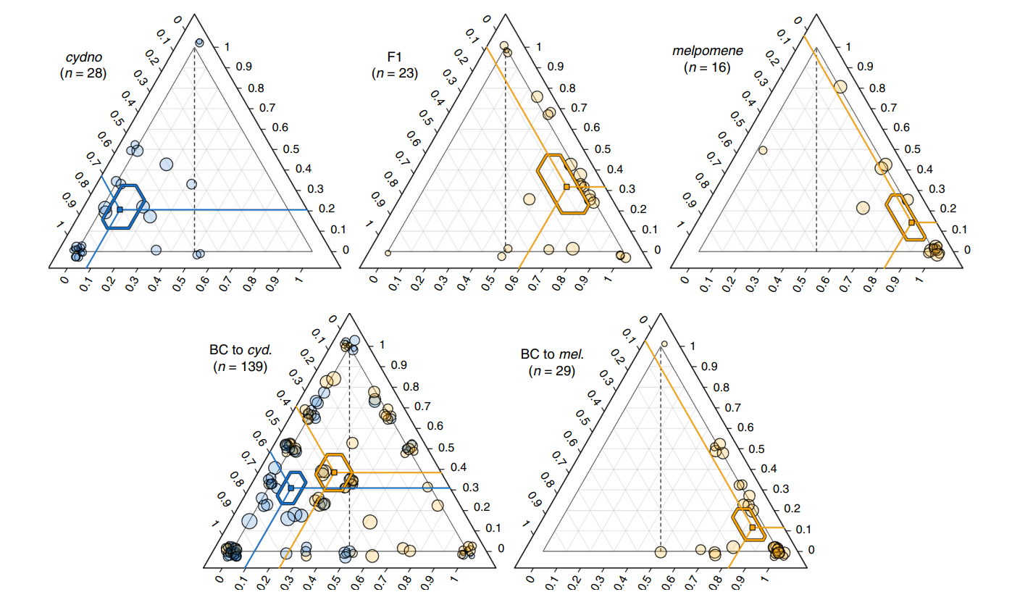

Slide 46
Females’ Choice
First, how are we to define female "choice"?
Notes:
If males of kind A are more successful than males of kind B, this may be because they are more active in seeking mates, or because they drive B males away: if so, the females cannot be said to be choosing.

Slide 47
Females’ Choice
First, how are we to define female "choice"?
The models are as follows:
Absolute preference.
Fixed relative preference (open-ended search).
Best of N males (truncated search).

Slide 48
A little of Supernormality
“Why do some animals respond more to stimuli that neither they nor (presumably) their forebears have ever seen than to the natural stimulus?“

Slide 49
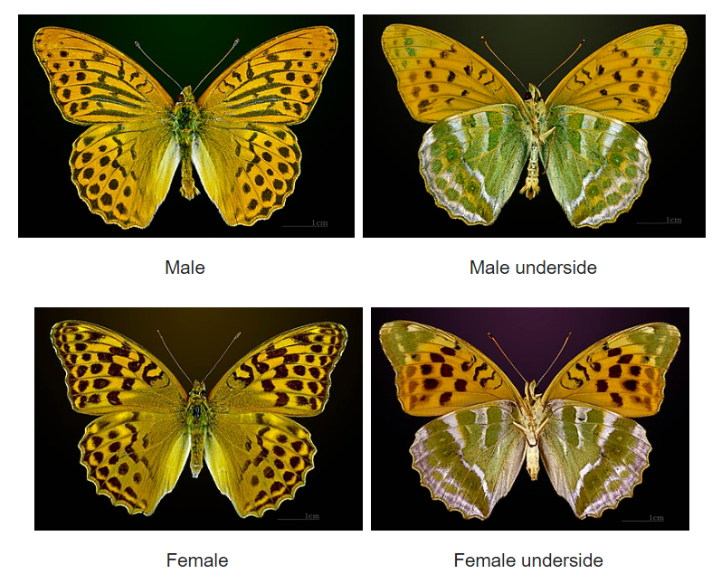
A little of Supernormality

Slide 50
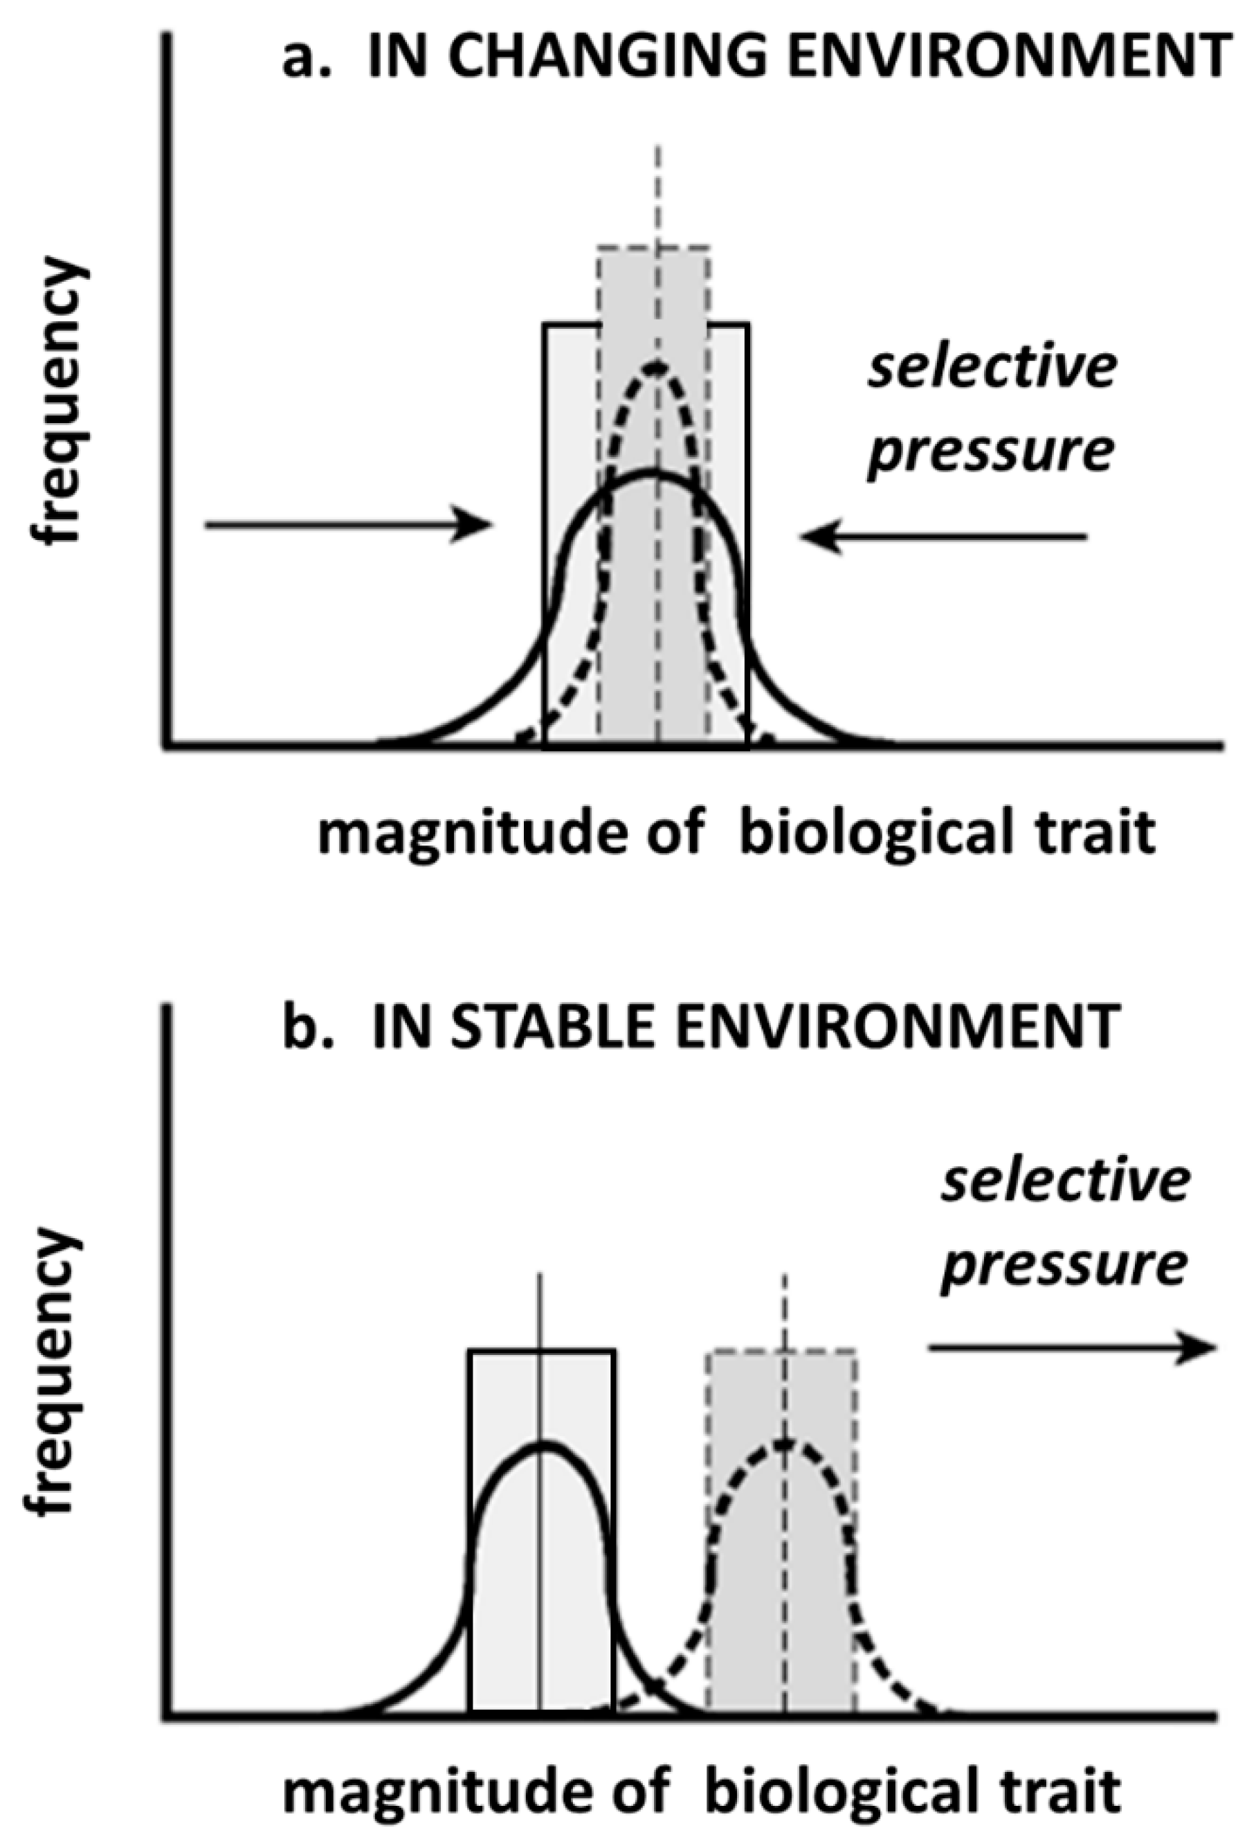
A little of Supernormality

Slide 51
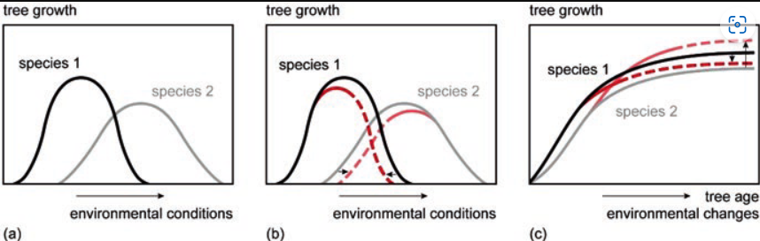
A little of Supernormality

Slide 52
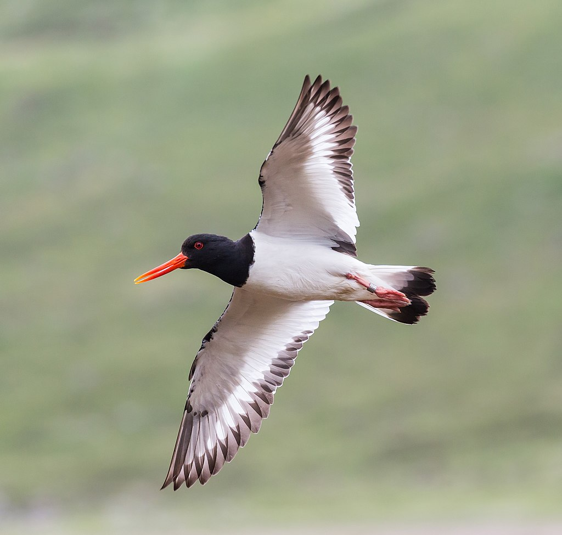
A little of Supernormality

Slide 53
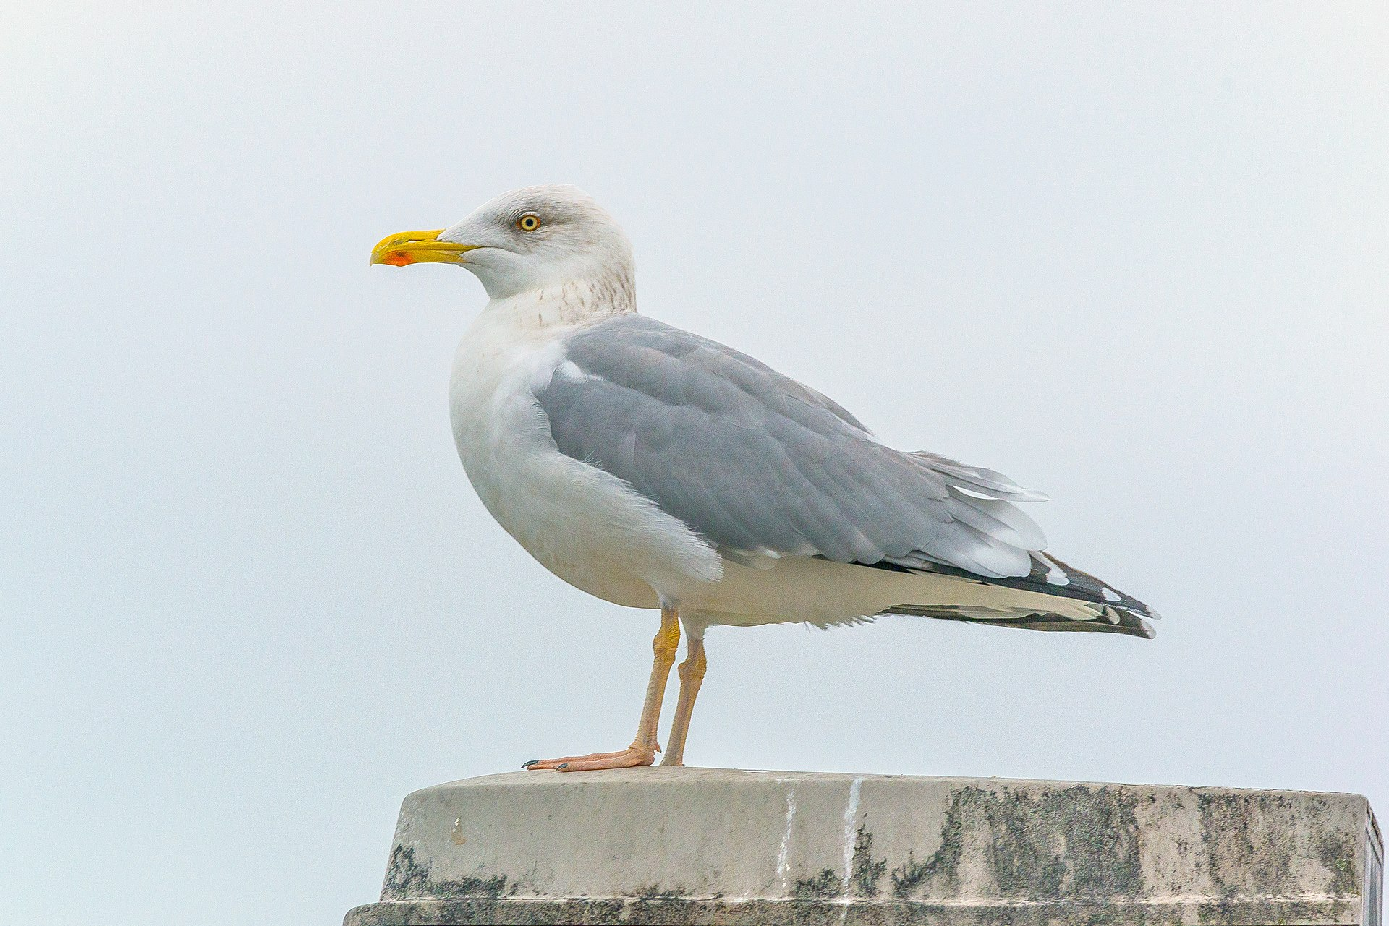
A little of Supernormality

Slide 54
O’ Donald 1967’ Model

Slide 55
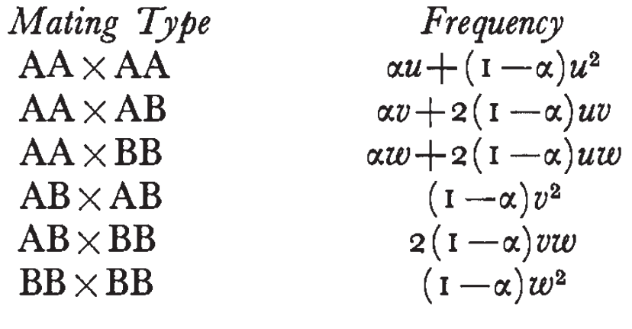
O’ Donald 1967’ Model

Slide 56
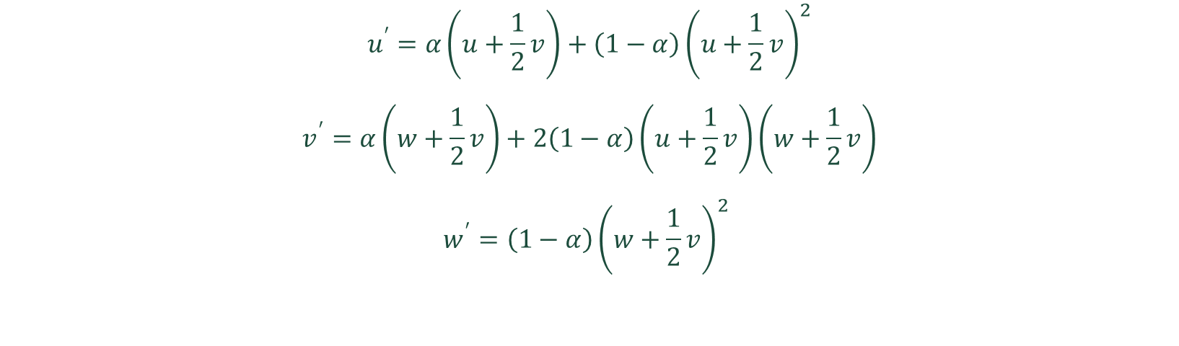
O’ Donald 1967’ Model
$$u^{′}=α\left(u+\frac{1}{2}v\right)+\left(1−α\right){\left(u+\frac{1}{2}v\right)}^{2}$$
$$v^{′}=α\left(w+\frac{1}{2}v\right)+2\left(1−α\right)\left(u+\frac{1}{2}v\right)\left(w+\frac{1}{2}v\right)$$
$$w^{′}=\left(1−α\right){\left(w+\frac{1}{2}v\right)}^{2}$$

Slide 57
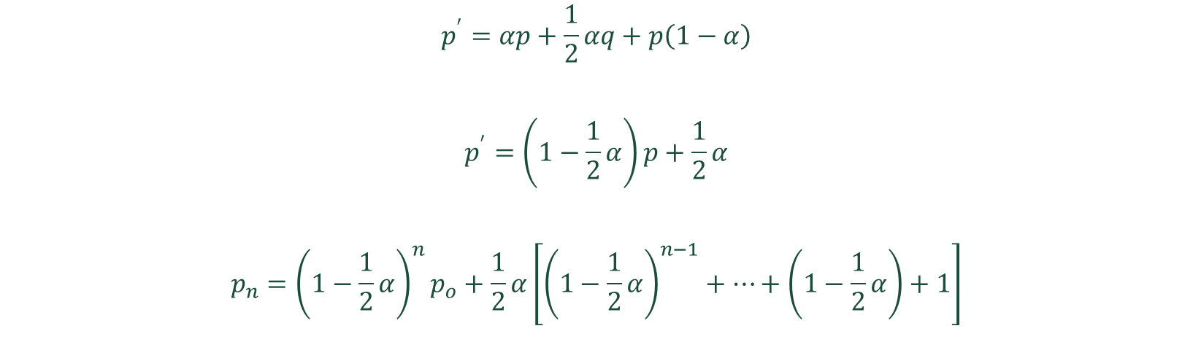
O’ Donald 1967’ Model
$$p^{′}=αp+\frac{1}{2}αq+p\left(1−α\right)$$
$$p^{′}=\left(1−\frac{1}{2}α\right)p+\frac{1}{2}α$$
$$p_{n}={\left(1−\frac{1}{2}α\right)}^{n}p_{o}+\frac{1}{2}α\left[{\left(1−\frac{1}{2}α\right)}^{n−1}+…+\left(1−\frac{1}{2}α\right)+1\right]$$

Slide 58

O’ Donald 1967’ Model
$$p_{n}={\left(1−\frac{1}{2}α\right)}^{n}p_{o}+1−{\left(1−\frac{1}{2}α\right)}^{n}$$
$$p_{n}={\left(1−\frac{1}{2}α\right)}^{n}\left(p_{o}−1\right)+1$$

Slide 59
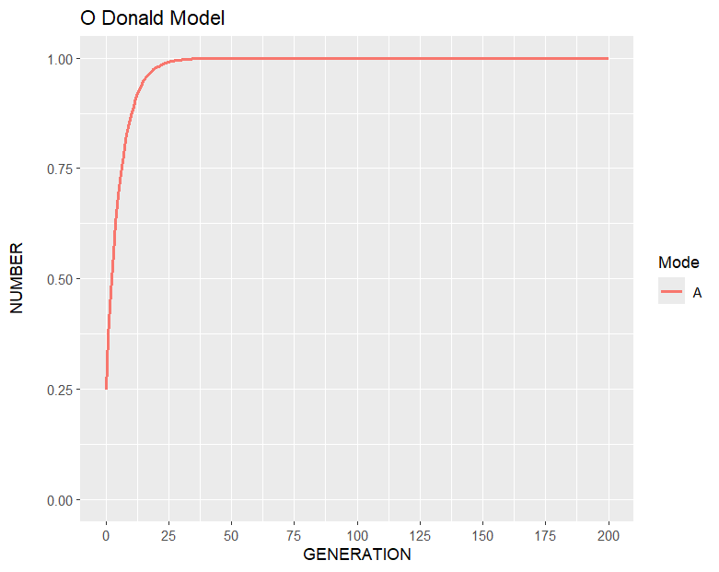
O’ Donald 1967’ Model

Slide 60
Lande 1981’s Model

Slide 62

Lande 1981’s Model
$$p^{∗}\left(z\right)=\frac{ω^{∗}\left(z\right)p\left(z\right)}{∫ω^{∗}\left(z\right)p\left(z\right) dz}$$
$$ω^{∗}\left(z\right)=e^{− {\left(z−θ\right)}^{2}/2ω^{2}}$$
$$ψ^{∗}\left(z|y\right)=\frac{ψ\left(z|y\right)}{∫p^{∗}\left(z\right)ψ\left(z|y\right)dz}$$
$$W\left(z\right)=ω^{∗}\left(z\right)∫q\left(z\right)ψ^{∗}\left(z|y\right)dy$$

Slide 63
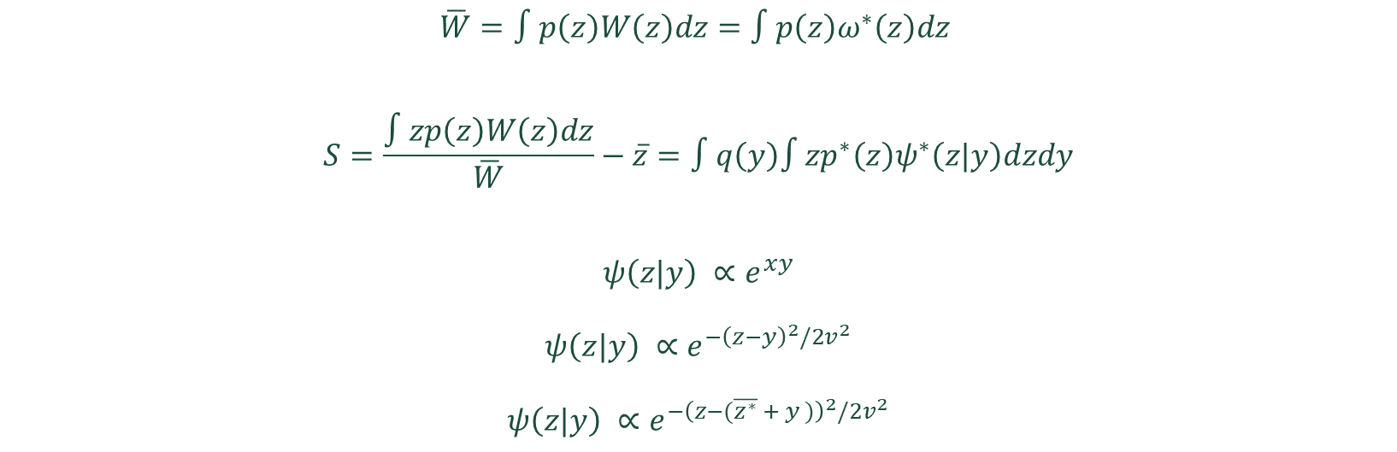
Lande 1981’s Model
$$\overline{W}=∫p\left(z\right)W\left(z\right)dz=∫p\left(z\right)ω^{∗}\left(z\right)dz$$
$$S=\frac{∫zp\left(z\right)W\left(z\right)dz}{\overline{W}}−\overline{z}=∫q\left(y\right)∫zp^{∗}\left(z\right)ψ^{∗}\left(z|y\right)dzdy$$
$$ψ\left(z|y\right) ∝e^{xy}$$
$$ψ\left(z|y\right) ∝e^{−{\left(z−y\right)}^{2}/2v^{2}}$$
$$ψ\left(z|y\right) ∝e^{−{\left(z−(\overline{z^{∗}} + y )\right)}^{2}/2v^{2}}$$

Slide 64
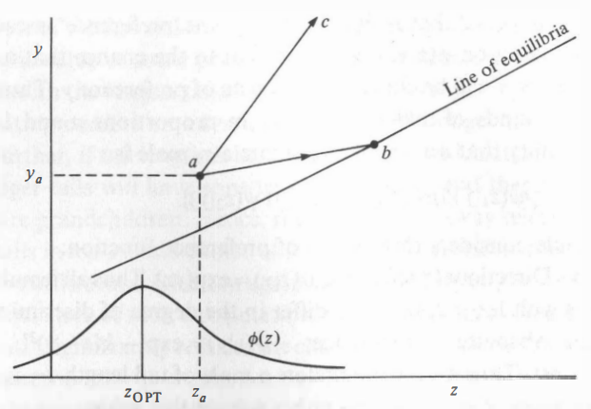

Slide 65
Kirkpatrick 1982’s Model

Slide 66

Kirkpatrick 1982’s Model
$$t_{2}^{′}=\frac{\left(1−s\right)t_{2}}{M}$$
$$t_{1}^{′}=\frac{t_{1}}{M}$$
$$V_{2}=t_{2}^{′}p_{1}+U_{2}p_{2}$$
$$V_{1}=t_{1}^{′}p_{1}+U_{1}p_{2}$$

Slide 67

Kirkpatrick 1982’s Model
$$W_{2}=(t_{2}^{′}p_{1}+U_{2}p_{2})/t_{2}$$
$$W_{1}=(t_{1}^{′}p_{1}+U_{1}p_{2})/t_{1}$$
$$U_{2}=\frac{α_{2}t_{2}^{′}}{t_{1}^{′}+α_{2}t_{2}^{′}}$$
$$U_{1}= \frac{t_{1}^{′}}{t_{1}^{′}+α_{2}t_{2}^{′}}$$

Slide 68

Kirkpatrick 1982’s Model
$$W_{2}=\left(1−s\right)\left(\frac{p_{1}}{M}+\frac{α_{2}p_{2}}{A}\right)$$
$$W_{1}=\frac{p_{1}}{M}+\frac{p_{2}}{A}$$
$$\hat{p_{2}}=B(1+C\hat{t_{2}})$$

Slide 69
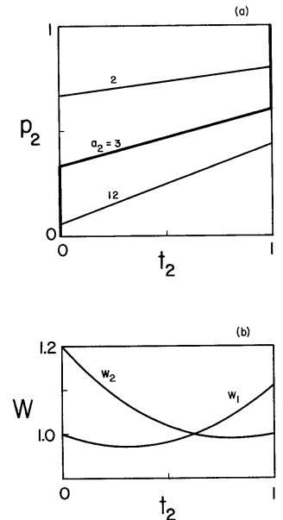

Slide 70

Kirkpatrick 1982’s Model
$$x_{1}=t_{1}p_{1}+D$$
$$x_{2}=t_{1}p_{2}−D$$
$$x_{3}=t_{2}p_{1}−D$$
$$x_{4}=t_{2}p_{2}+D$$
$$x_{1}^{′}=x_{1}/M$$
$$x_{2}^{′}=x_{2}/M$$
$$x_{3}^{′}=(1−s)x_{3}/M$$
$$x_{4}^{′}=(1−s)x_{4}/M$$

Slide 71
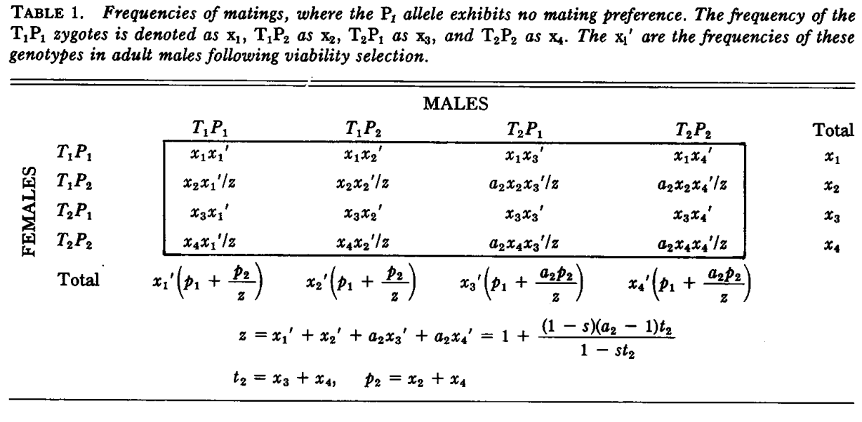

Slide 72
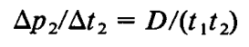
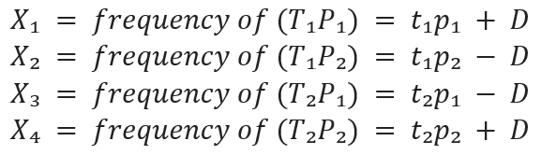

Kirkpatrick 1982’s Model
$$U_{1}^{′}=U_{1}/t_{1}^{′}$$
$$U_{2}^{′}=U_{2}/t_{2}^{′}$$

Slide 73
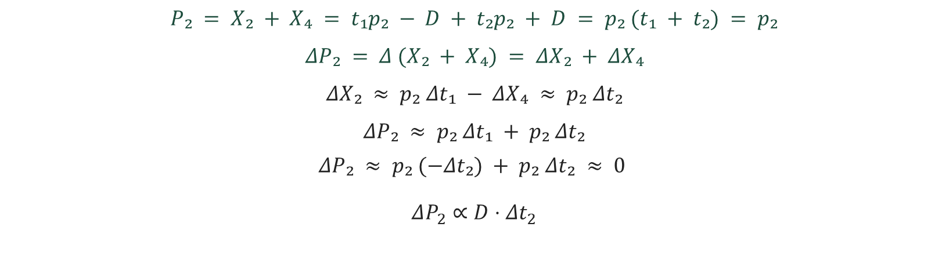
Kirkpatrick 1982’s Model
$$P₂ = X₂ + X₄ = t₁p₂ − D + t₂p₂ + D = p₂ (t₁ + t₂) = p₂$$
$$ΔP₂ = Δ (X₂ + X₄) = ΔX₂ + ΔX₄$$
$$ΔX₂ ≈ p₂ Δt₁ − ΔX₄ ≈ p₂ Δt₂$$
$$ΔP₂ ≈ p₂ Δt₁ + p₂ Δt₂$$
$$ΔP₂ ≈ p₂ (−Δt₂) + p₂ Δt₂ ≈ 0$$
$$ΔP_{2}​∝D⋅Δt_{2}$$

Slide 74
Seger 1985’s Model

Slide 75

Seger 1985’s Model
$$U_{2}=t_{2}^{′}+ct_{1}^{′}t_{2}^{′}$$
$$W_{2}=\frac{1−s}{M}\left(1+\frac{cp_{2}\left(1−t_{2}\right)}{M}\right)$$
$$W_{1}=\frac{1}{M}\left(1−\frac{c\left(1−s\right)p_{2}t_{2}}{M}\right)$$
$$U_{2}=1−{t_{1}^{′}}^{N}$$

Slide 76
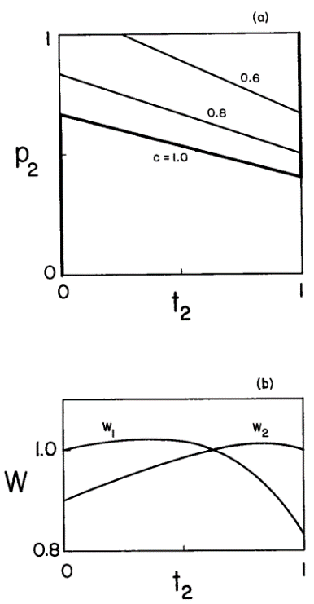

Slide 77
